Slide 1
Model Evaluation and Experimental Setup
CS3300 Data Science

Slide 2
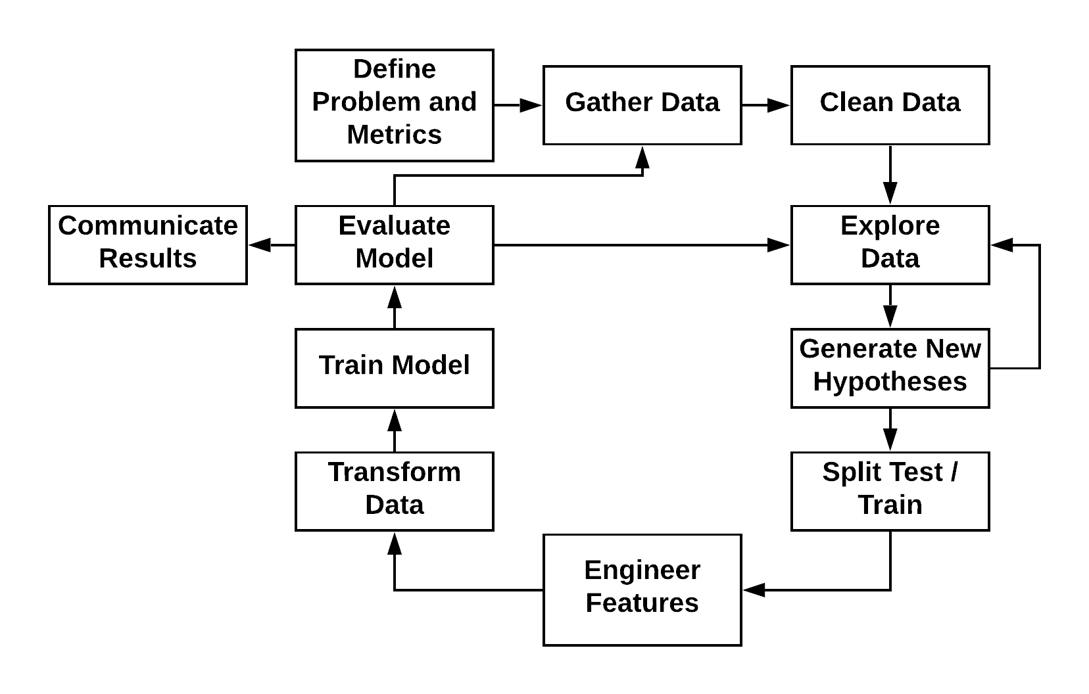
Machine Learning Process

Slide 3
Experimental Setup & Model Evaluation
In most real-world use cases, we want to:
Train a model on data we have
to make predictions on data we haven't seen yet
Examples:
Predict which emails are spam
Predict what ads a user will click on given their past history
Predict the price that a property will sell for

Slide 4
Experimental Setup & Model Evaluation
How do we characterize our model's performance?
Classification – Accuracy, Recall, Precision, etc…
Regression – Mean squared error, Absolute error, etc…
Visualization of these metrics
Confusion matrix
Receiver operating characteristic curves
Scatter plots of response vs. prediction (line of identity)
Plotting of residuals vs the true value

Slide 5
Experimental Setup & Model Evaluation
Other than characterizing our models with performance metrics, it is often helpful to evaluate whether our models are better than other approaches.
We may want a “line in the sand” to compare our model performance to.
For instance, if two observations occupy the same point in feature space but have different response labels it may not be possible for us to achieve 100% accuracy.
Does that mean if we don’t achieve 100% accuracy, our model is no good?
How can we judge this?

Slide 6
Baseline Models
Models that we can use for reference – to judge the characterization of our trained models.
Uniform or random selection among labels
Most common label appearing in the training data
Most accurate single-feature model
Somebody else’s model
Expected upper bounds from human annotations
We can also use these models, and their evaluation metrics, to establish confidence in our model’s predictions

Slide 7
Experimental Setup & Model Evaluation
We want our experiments to tell us how a model will perform when applied to unseen data
We design our experiment to match the real-world use case
We divide data (records) into:
Training set – used for training the model
Validation set – used for optimizing model hyper-parameters (most commonly used with deep learning)
Testing set – used for evaluating the model's predictions
Since the testing set data is not used at all in training, it becomes an accurate way to evaluate a model's performance on unseen data

Slide 8
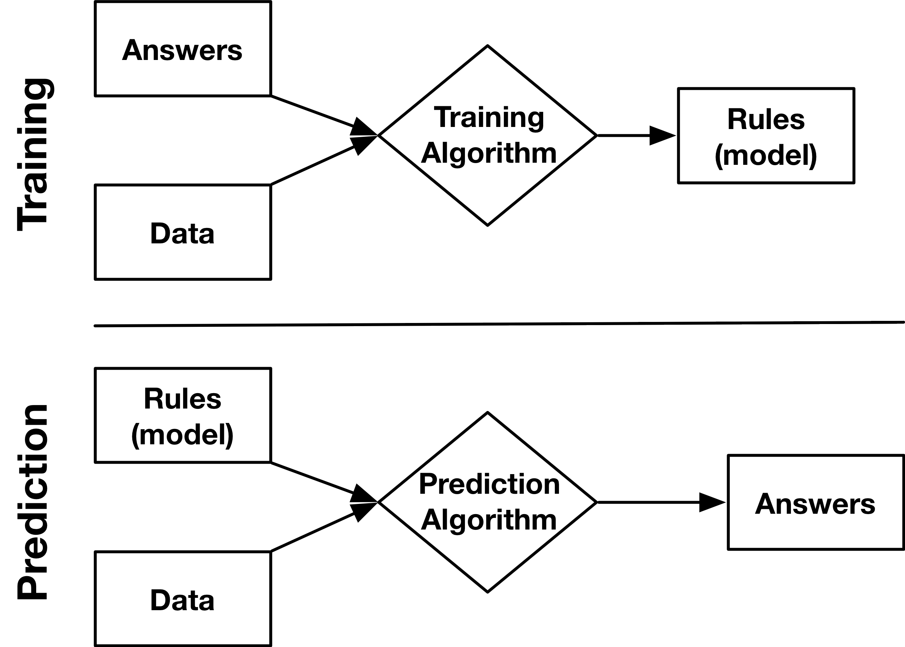
Machine Learning
Training Set
Validation Set
Test Set

Slide 9
Training Problems
Overfitting
Leaking Labels

Slide 10
Holdout Method (“validation” - Train-Test Split)
Random Sampling without Replacement
Simplest approach
Appropriate for regression problems that are not time dependent
Procedure
For each record, flip a coin to decide if the record goes into the training or testing set
Frequently, 70% of records are used for training and 30% for testing

Slide 11
Holdout Method – Validation
Stratification Followed by Random Sampling without Replacement
Ensures that the class ratios for the training and testing sets match the original data set
Appropriate for classification problems
Procedure
Samples are divided by their class labels
Each class is divided into a training and testing set using random sampling without replacement
All training sets are merged to produce a single training set
All testing sets are merged to produce a single testing set

Slide 12
Holdout Method – Validation
Partition by Time
Used for data that depends on time (e.g., weather data)
Procedure
Choose a cutoff time: either a single point in time OR for each record individually
Training set: all records before the cutoff
Testing set: all records after the cutoff

Slide 13
Holdout Method – Validation
Records may not be independent
A single patient will have records from multiple points in time (e.g., one for each doctor visit)
If a patient's records end up in both sits, you will not be able to detect overfitting
Procedure
Organize the records into groups (all records belong to same patient)
Randomly assign entire groups to training or testing set (e.g., sampling with replacement, stratification)

Slide 14
Holdout Method – Validation
Complex situations may arise
Example: Predict whether a patient will be diagnosed with Alzheimer's in the future based on (other) past diagnoses
Time dependent: need to use records BEFORE Alzheimer's diagnoses for training
Class dependent: stratify by Alzheimer's vs not
Patient dependent: need to keep records grouped by patient

Slide 15
Holdout Method – Validation
Solution: Predict whether a patient will be diagnosed with Alzheimer's in the future based on (other) past diagnoses
Stratify patients by outcome (Alzheimer's vs not)
For Alzheimer's positive patients, divide each patients' records into before and after diagnosis; discard records from AFTER diagnosis
Within each class, assign patients using random sampling with replacement
Merge training and testing sets

Slide 16
Cross-fold Validation
Cross-fold validation is a more sophisticated approach to holdout cross validation (train-test splitting)
Instead of generating one split, the data is divided into multiple "folds"
Each datum is assigned to a single fold
You then loop through the folds, using each fold as the hold out set. You train on the remaining folds and evaluate the on the hold out set.
Allows you to calculate summary statistics on the predictor

Slide 17
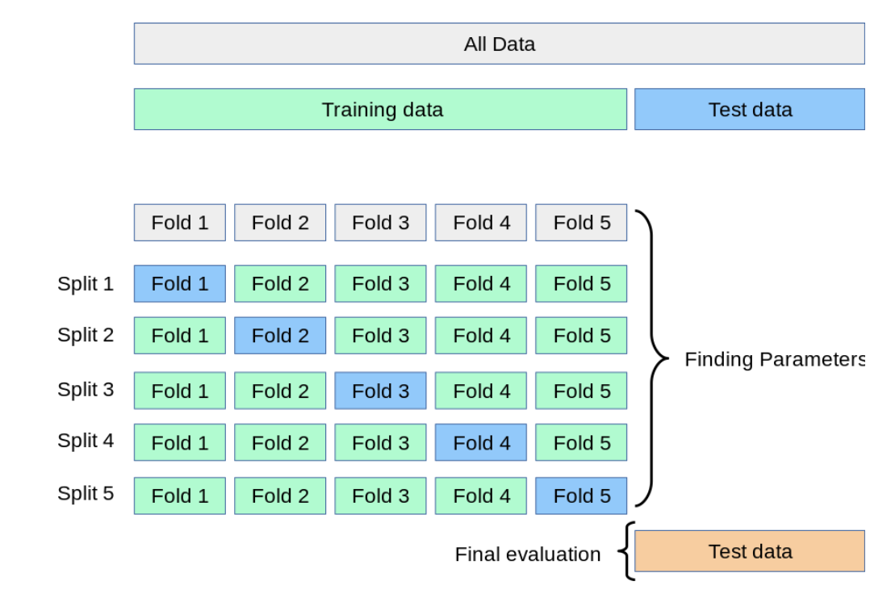
K-fold Cross Validation
Training data is dividing in k folds
The predictor is trained using all folds, but the hold out
Predictor performance is measured
This is repeated for each fold
Can be useful for adjusting model hyperparameters or evaluating different architectures
You want to save a separate test set for final testing

Slide 18
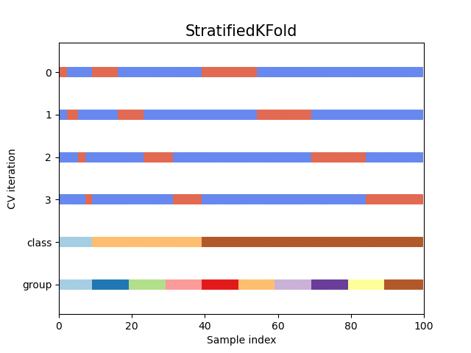
StratifiedKFold
We first stratify by class
Each class is divided into k-folds
The corresponding class folds are then merged.

Slide 19
Leave one out cross validation
Logical extreme of k-fold cross validation
Each fold is one observation
Often used when you have few observations
May be computationally expensive
May overestimate accuracy

Slide 20
Cross-fold validation example
Want to use cells/tissue types to predict cancer state in prostate
Epithelium, lumen, and Stroma
Low grade vs high grade cancer
Prostates are sliced into 10-20 samples
Each slice is an observation that a pathologist annotates
This means slice may not be independent
Limited number of graded tissues from pathologist
Expensive and time consuming

Slide 21
